Slide 1

TPS Reporting’s Weekly Report #4
Team Leader: Nicholas Alcorn
Other Members: Trevor Bal, Carl Moon II, Yasmina Rabhi, & Cameron Randolph

Slide 2
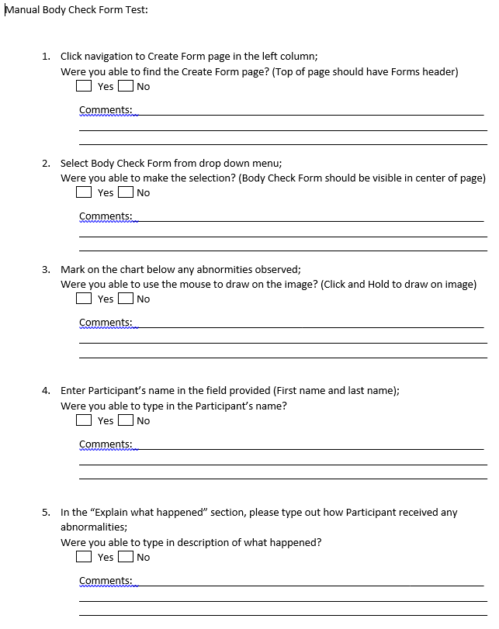
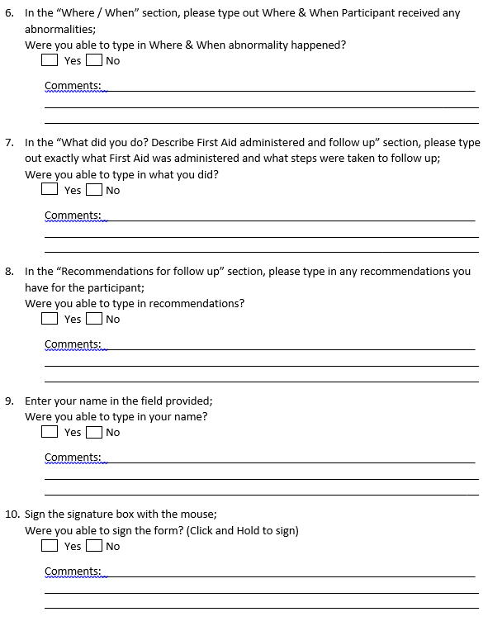
Tests

Slide 3
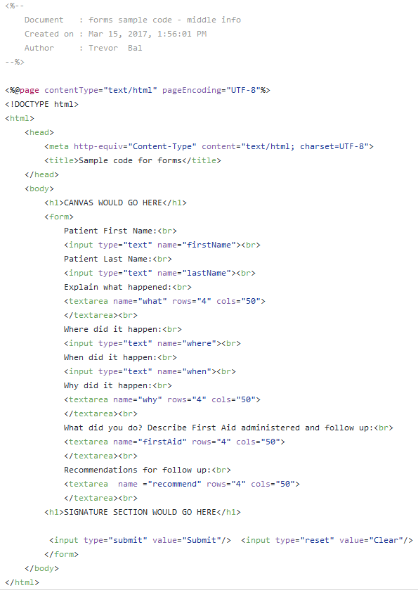
Running Code

Slide 4
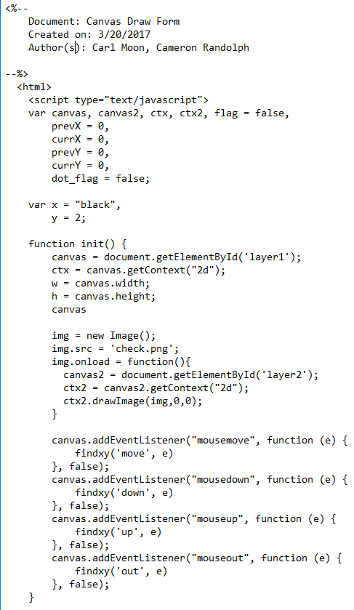
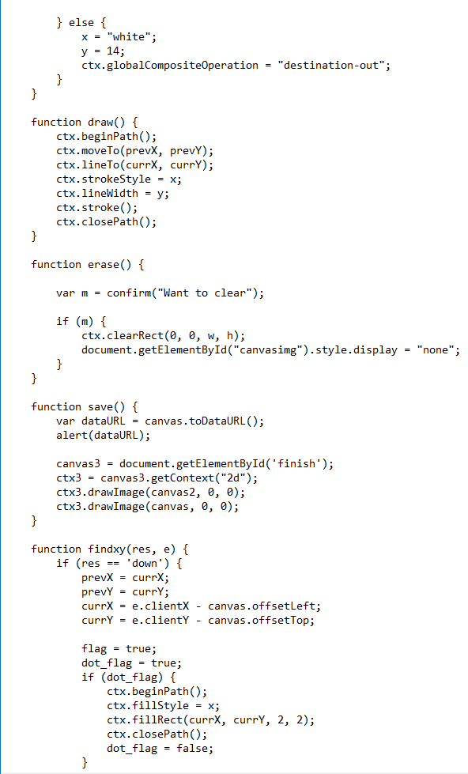
Running Code (Continued)

Slide 5


Project Plan

Slide 6
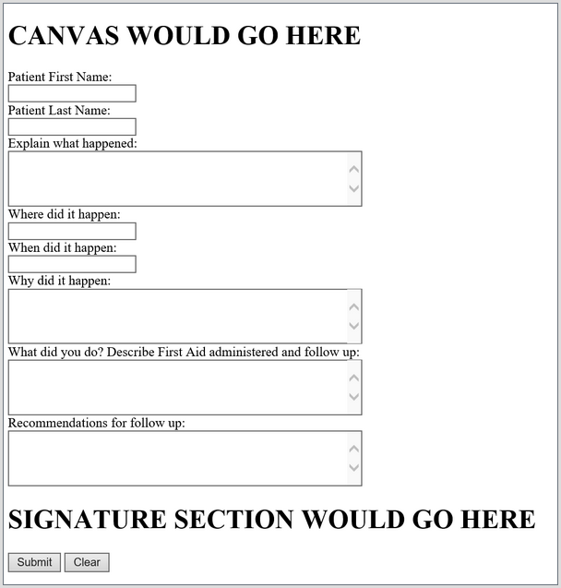
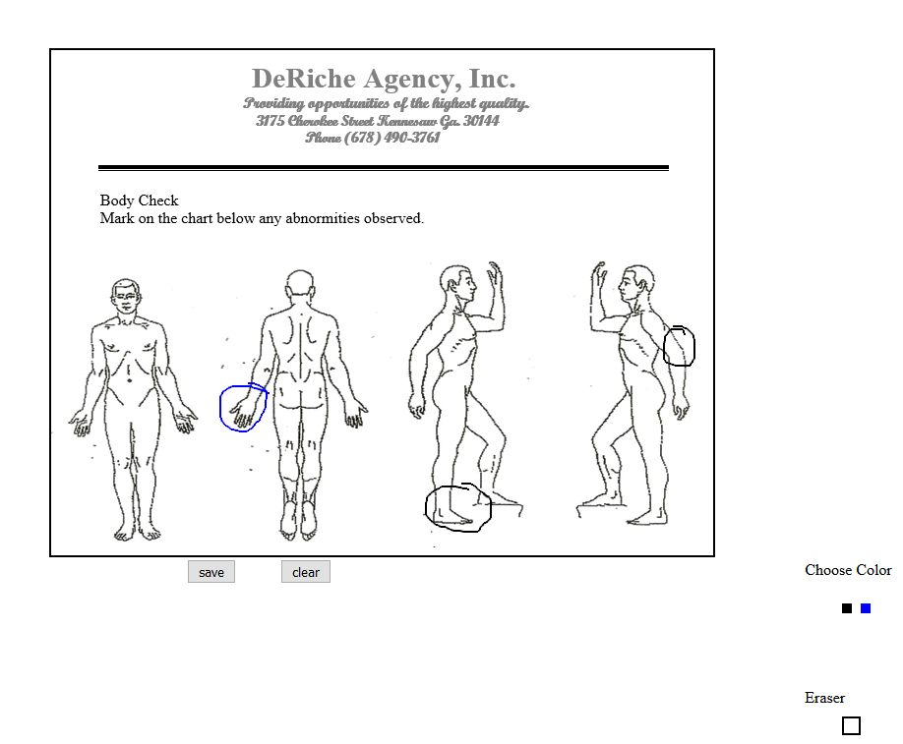
Deliverables

Slide 7
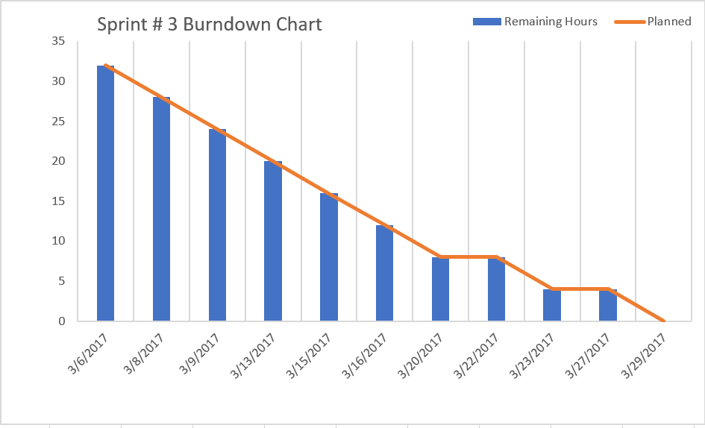
Deliverables

Slide 8

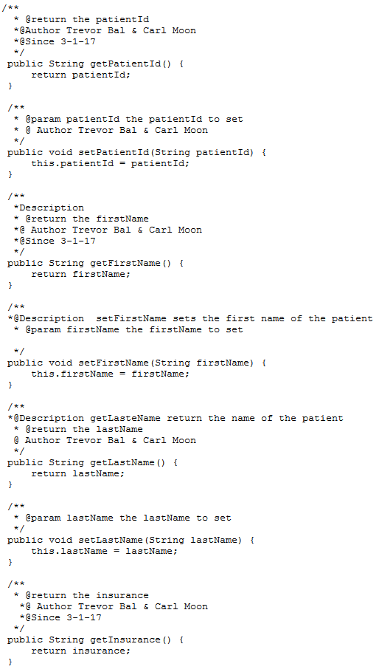

Deliverables (Documentation)

Slide 9
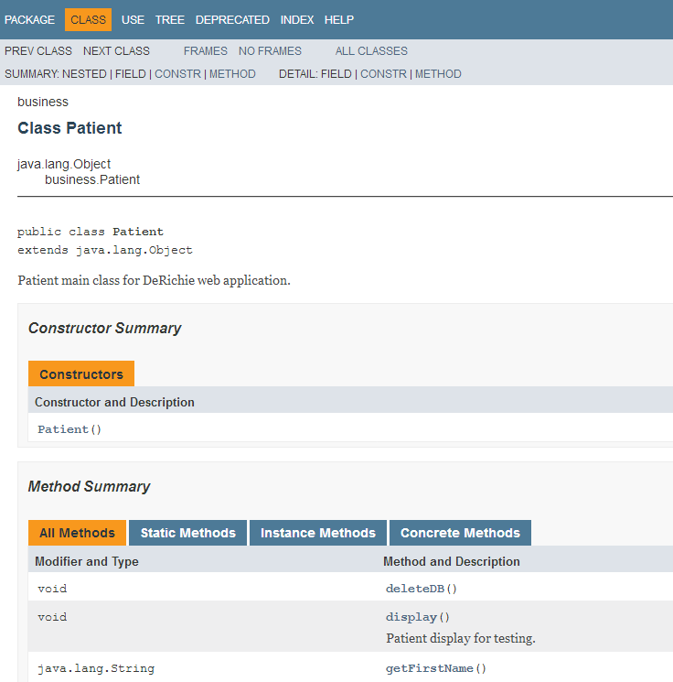
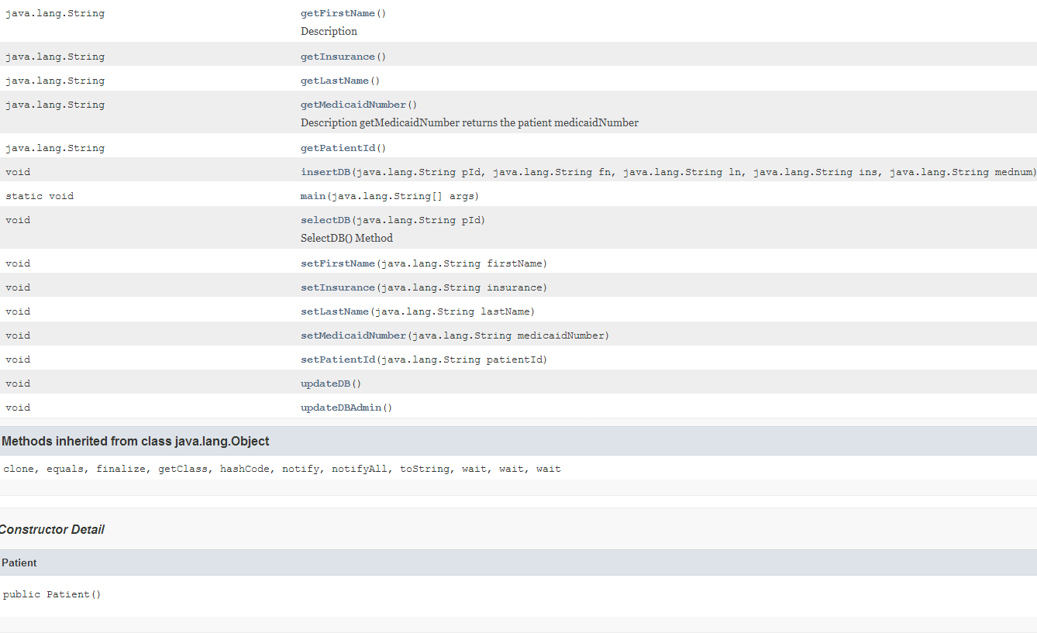
Deliverables (Documentation)

